Slide 1
Marvel vs DC Dashboard Story
File created on: 11/20/2022 11:19:25 PM

Slide 2
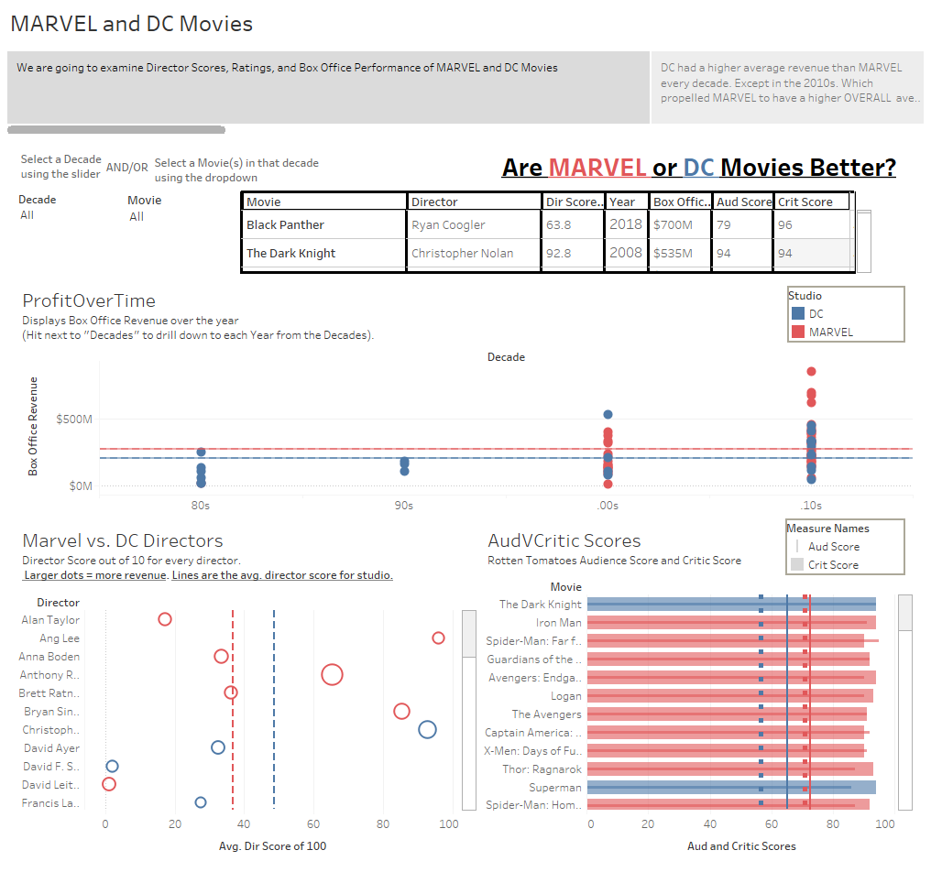

Slide 3
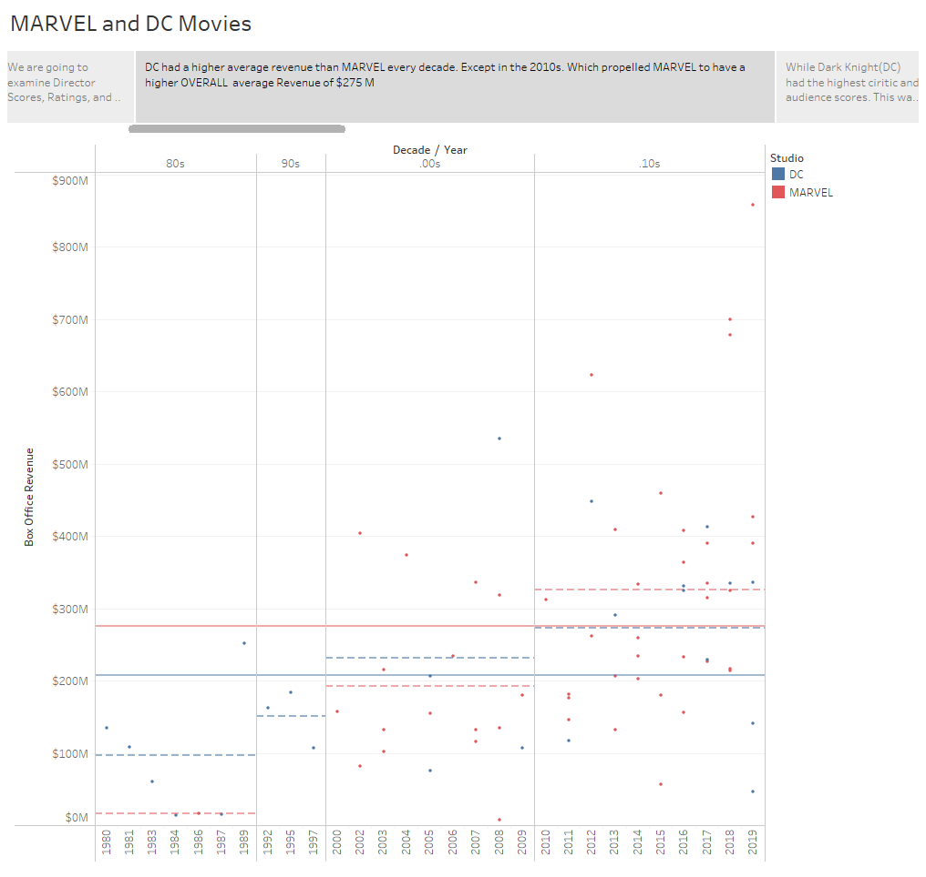

Slide 4
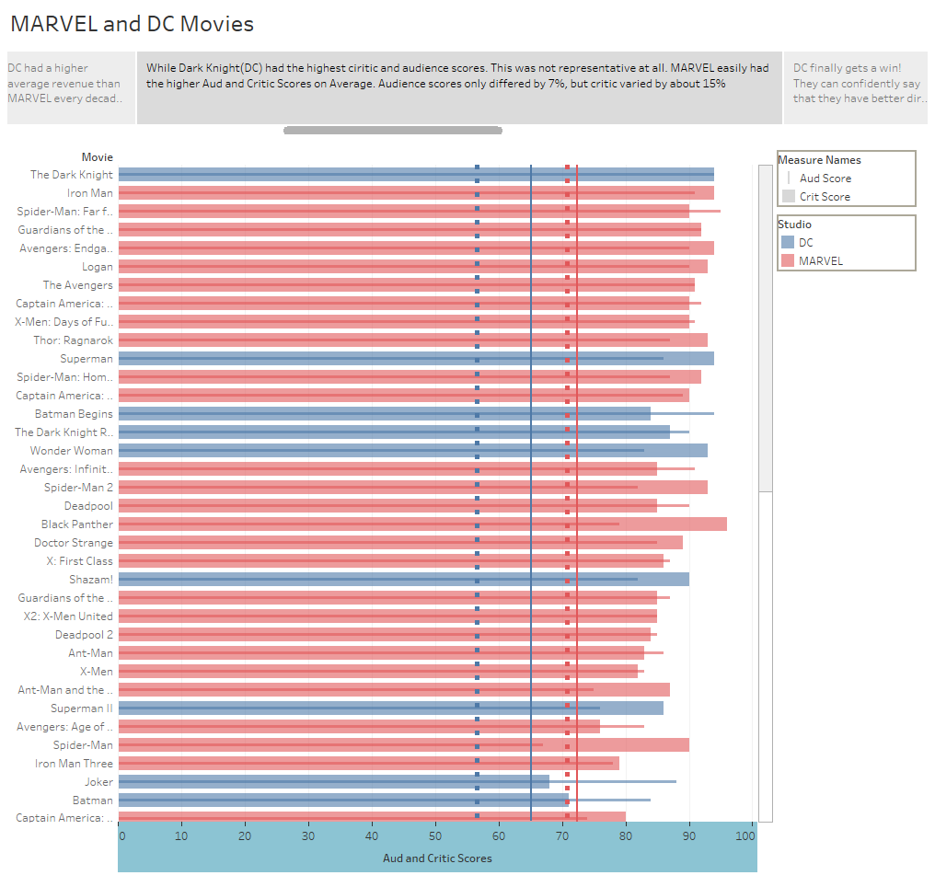

Slide 5
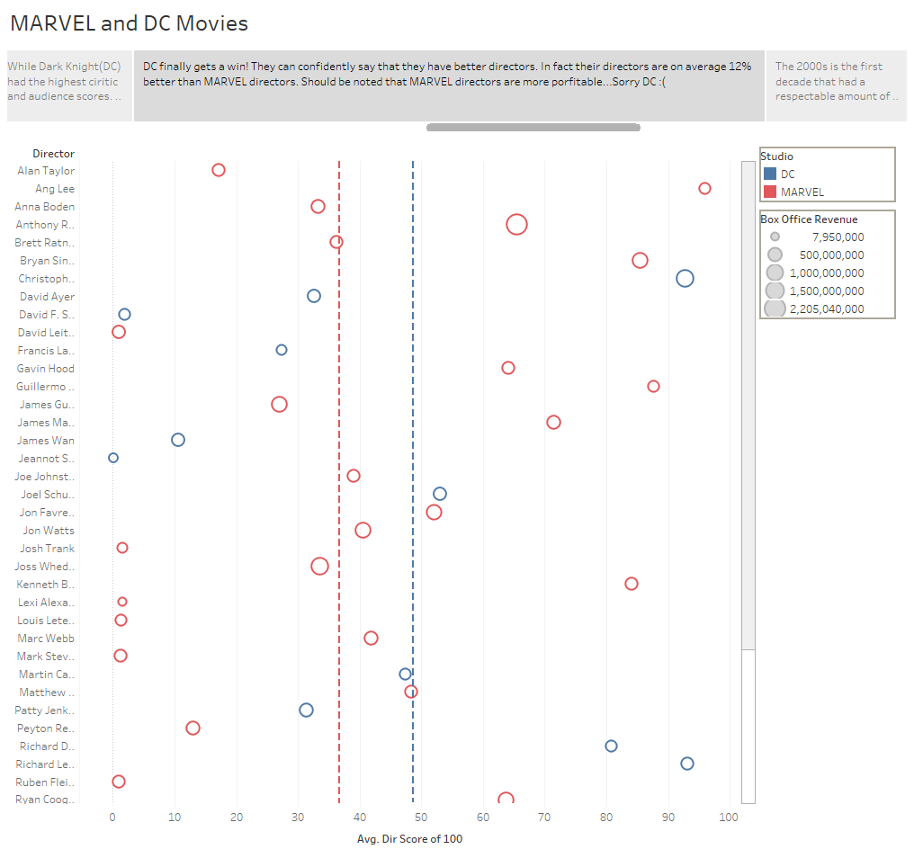

Slide 6
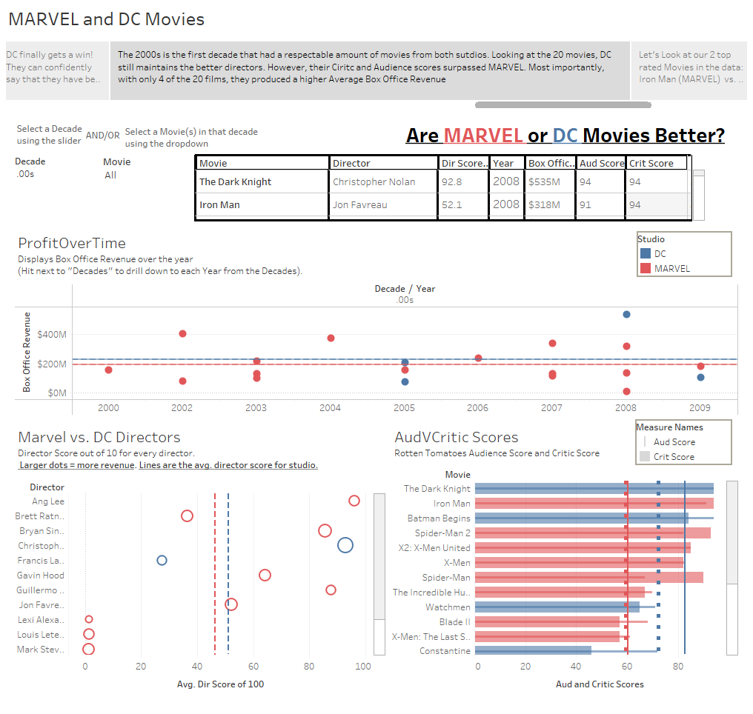

Slide 7
